Slide 1
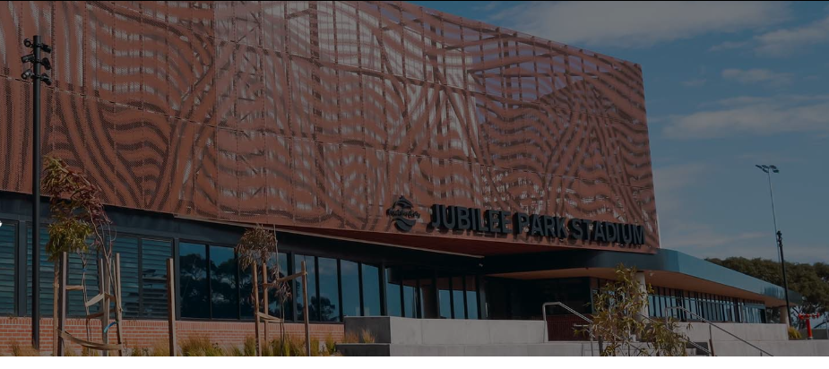
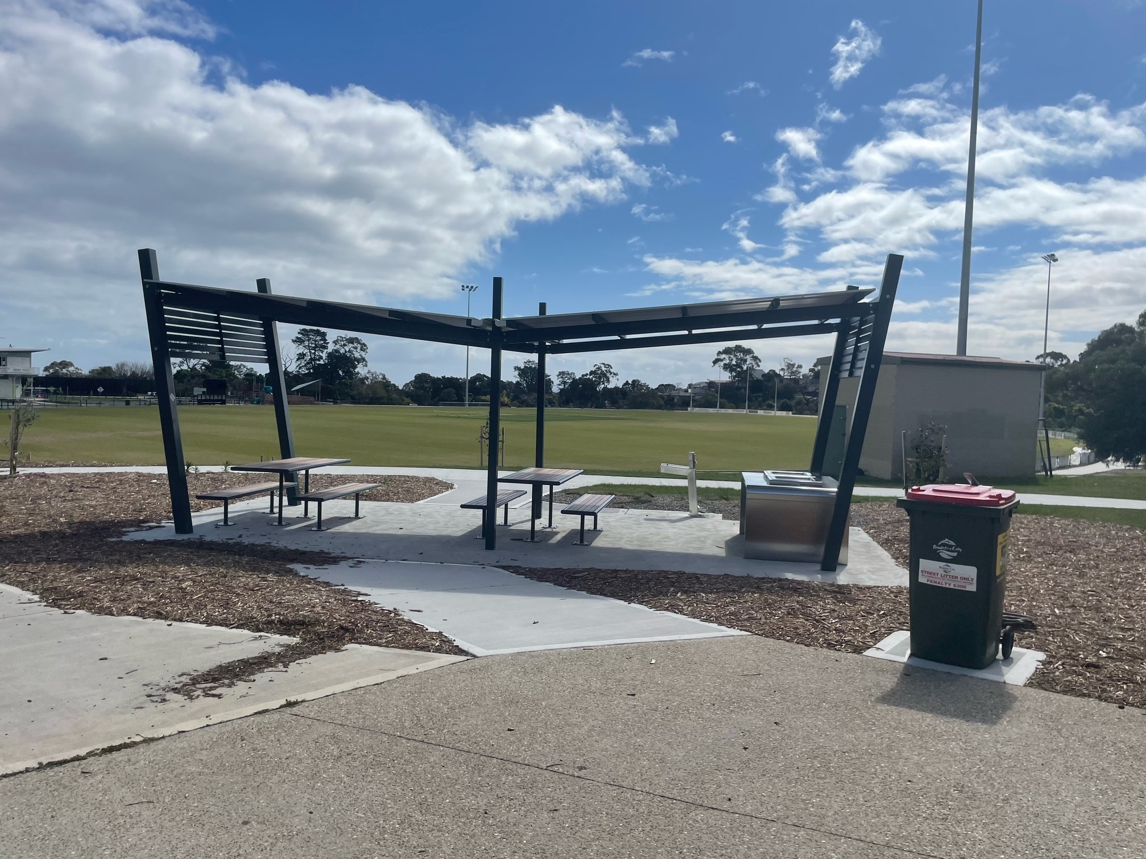
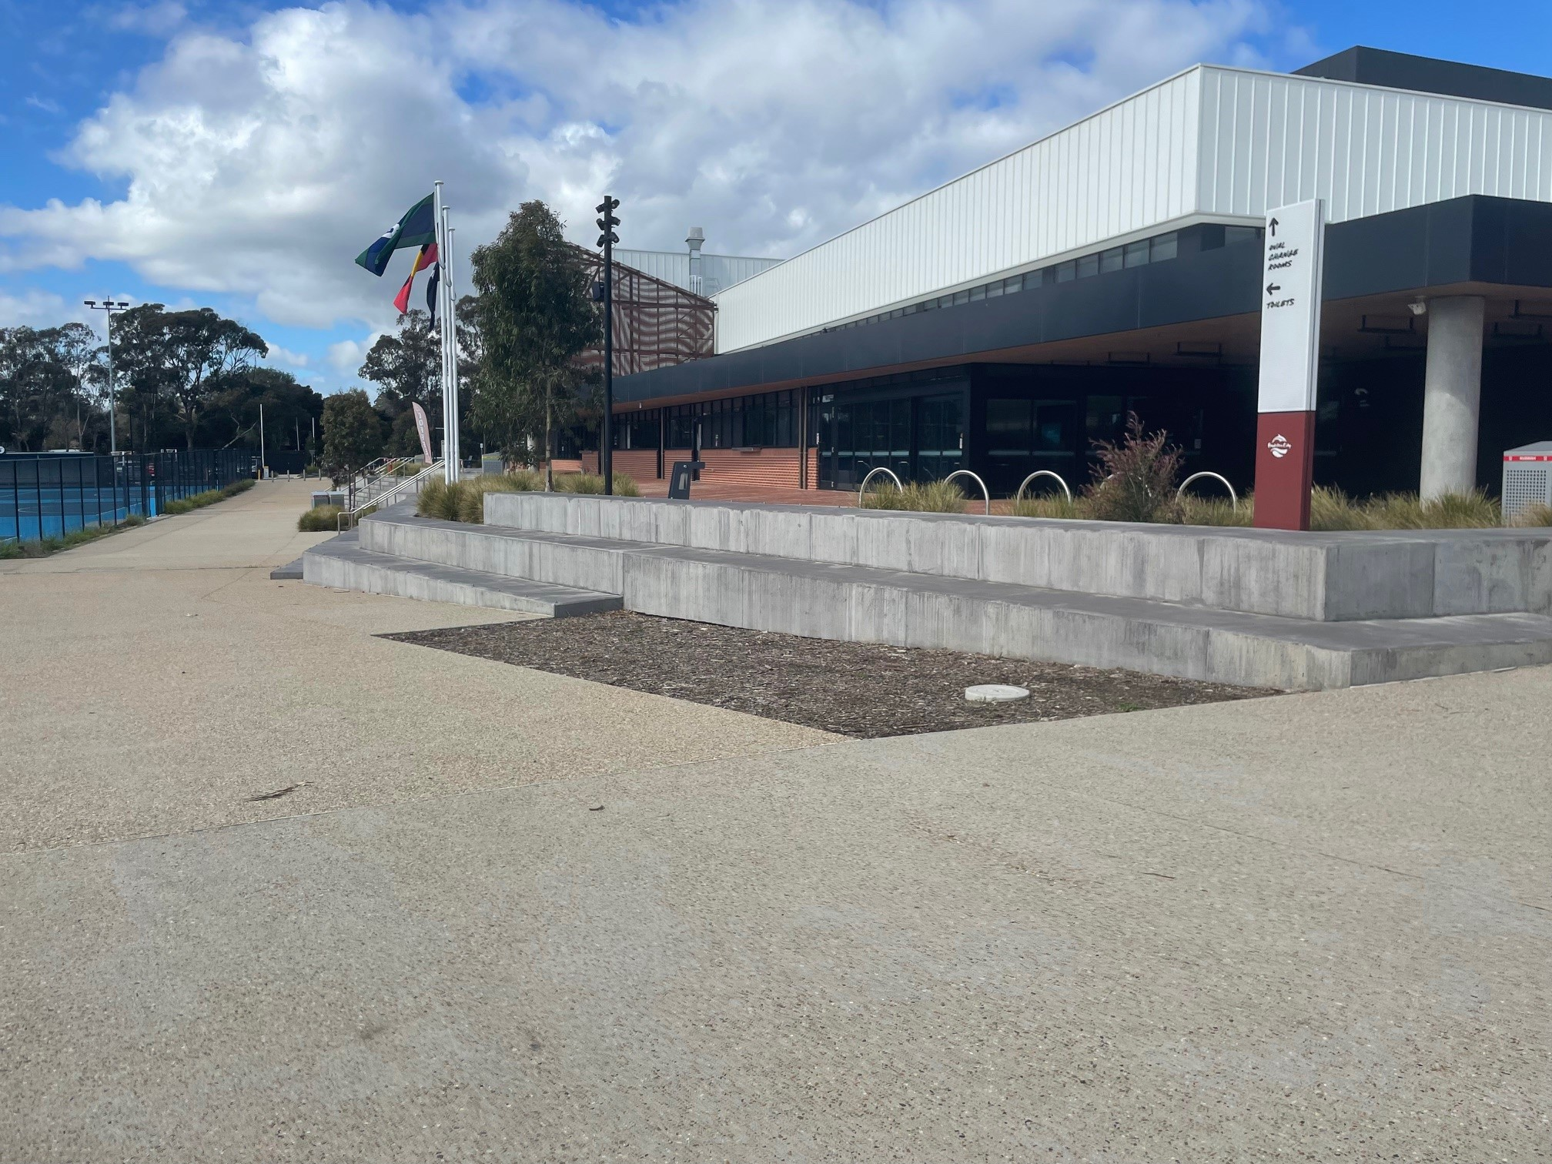
Going to Frankston City Councils
Children’s Week at
Jubilee Park.

Slide 2

There is a special event on for Children’s Week.
It is on Wednesday the 22nd October from 10:00 AM to 1:00 PM.

Slide 3
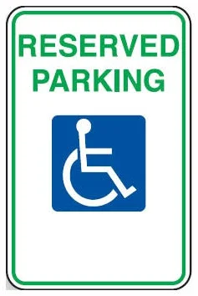
There will be accessible parking near the entrance.

Slide 4
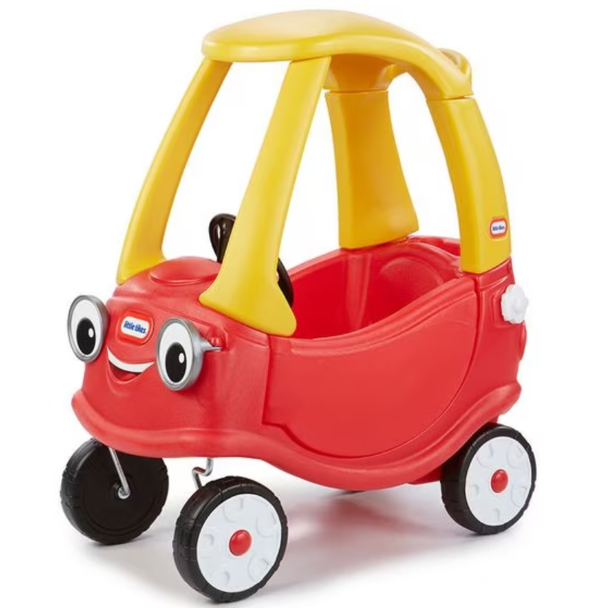
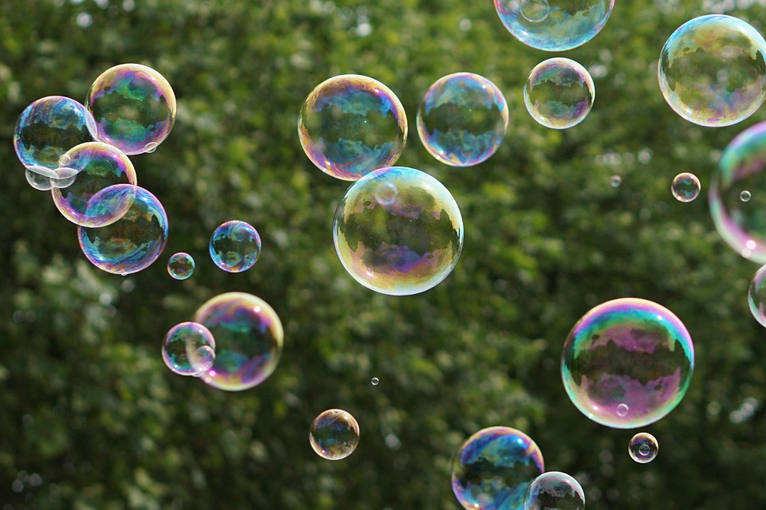
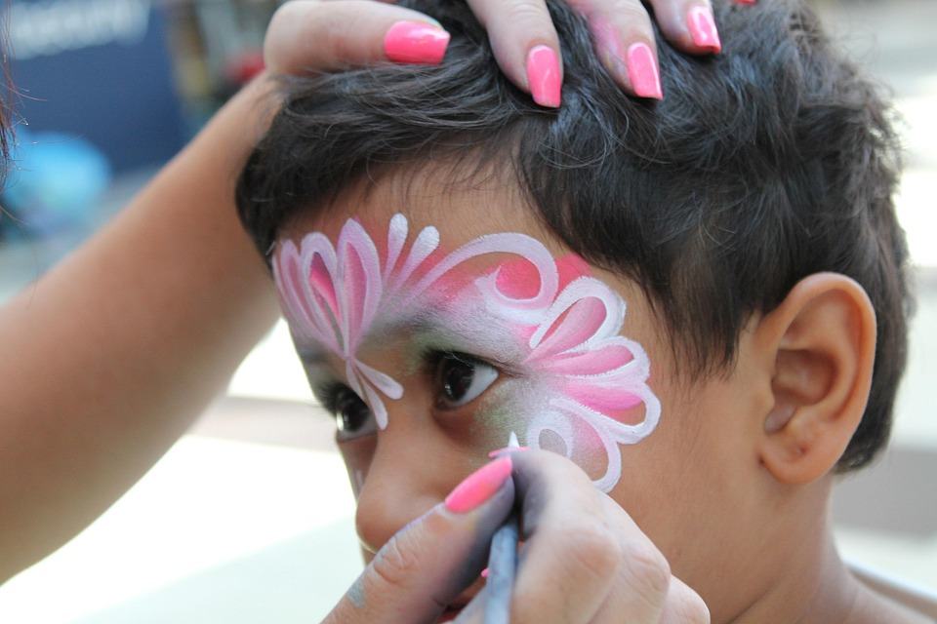
There will be lots of activities I can choose from.
There will be activities outside on the grass, the concrete and on the netball courts.

Slide 5

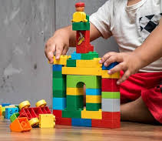
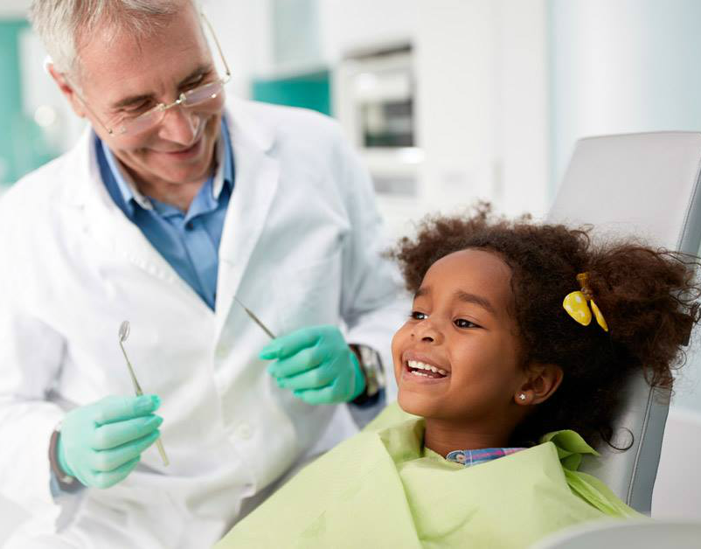
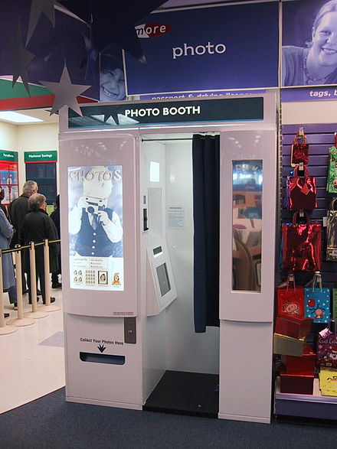
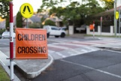
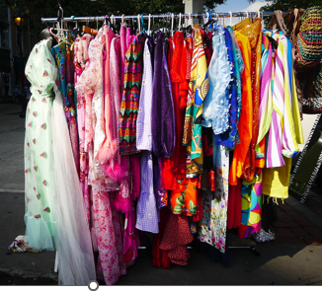
I can choose what activities I want to do. There will be lots of options like.....
Dental checks
Duplo
Lion mask making
Mini school crossing fun
Dress Ups
Photo booth

Slide 6

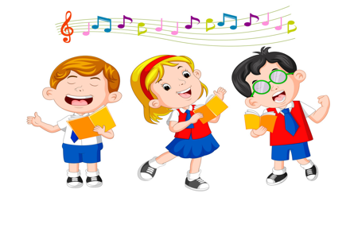
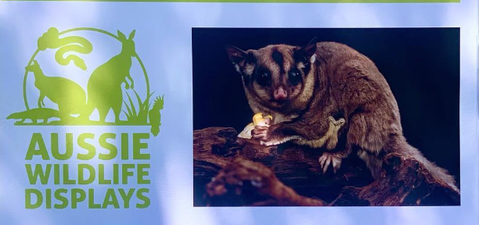
Sounds like
this music
Charlie Silly Pants
Aussie Wildlife

Slide 7
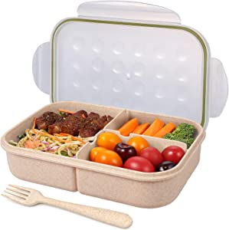
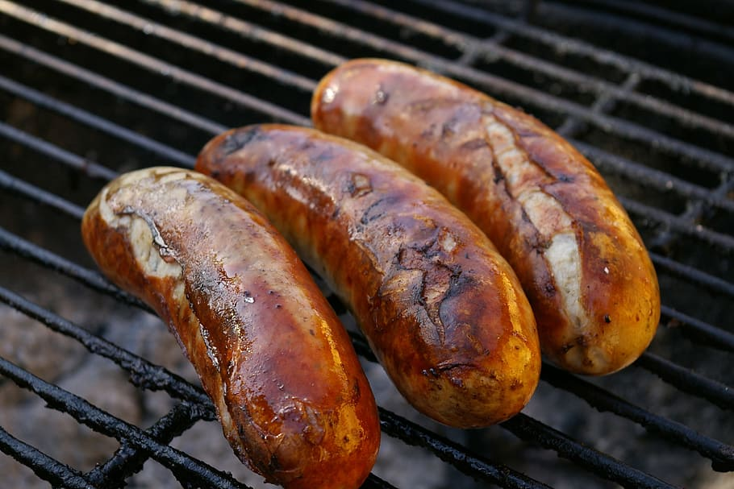
There will be BBQ sausages in bread provided or I can bring food from home and have a picnic at Jubilee Park.

Slide 8
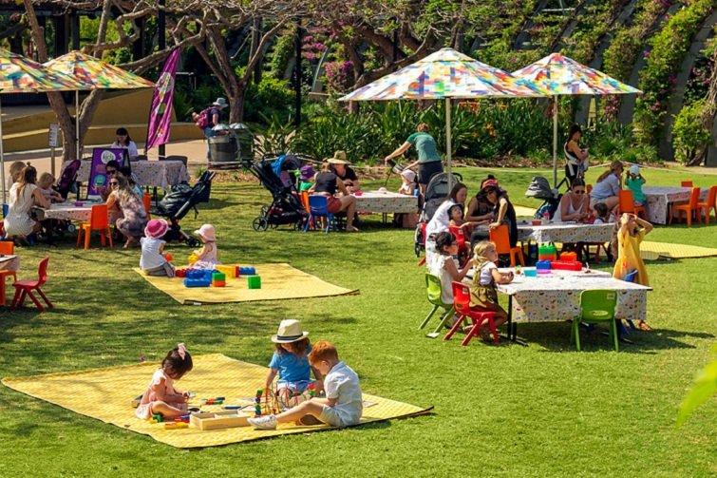
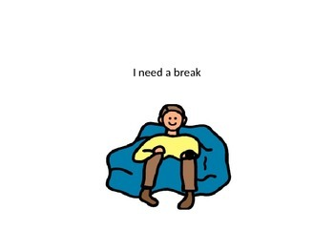
There will be lots of people there.
I can let an adult know if need a break.

Slide 9
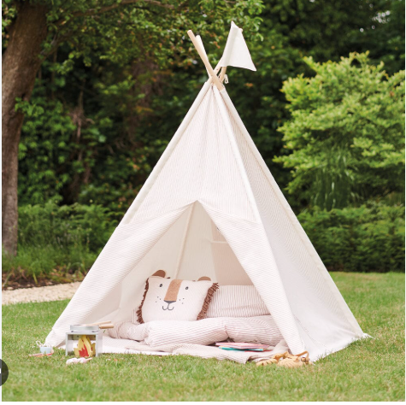
There will be a chill out space.
I can go to the Zen Zone and chill out space if
I want some quiet time.

Slide 10
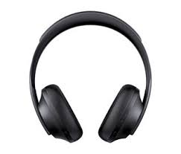
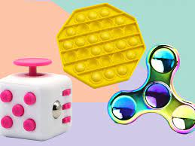
There are other things I can do if I feel overwhelmed.
I can bring a fidget toy and headphones from home.

Slide 11

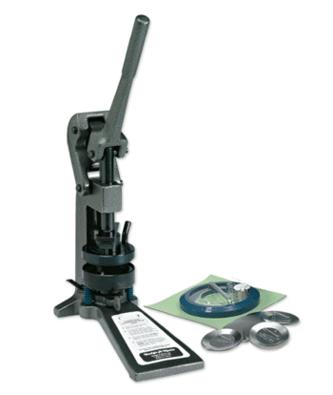

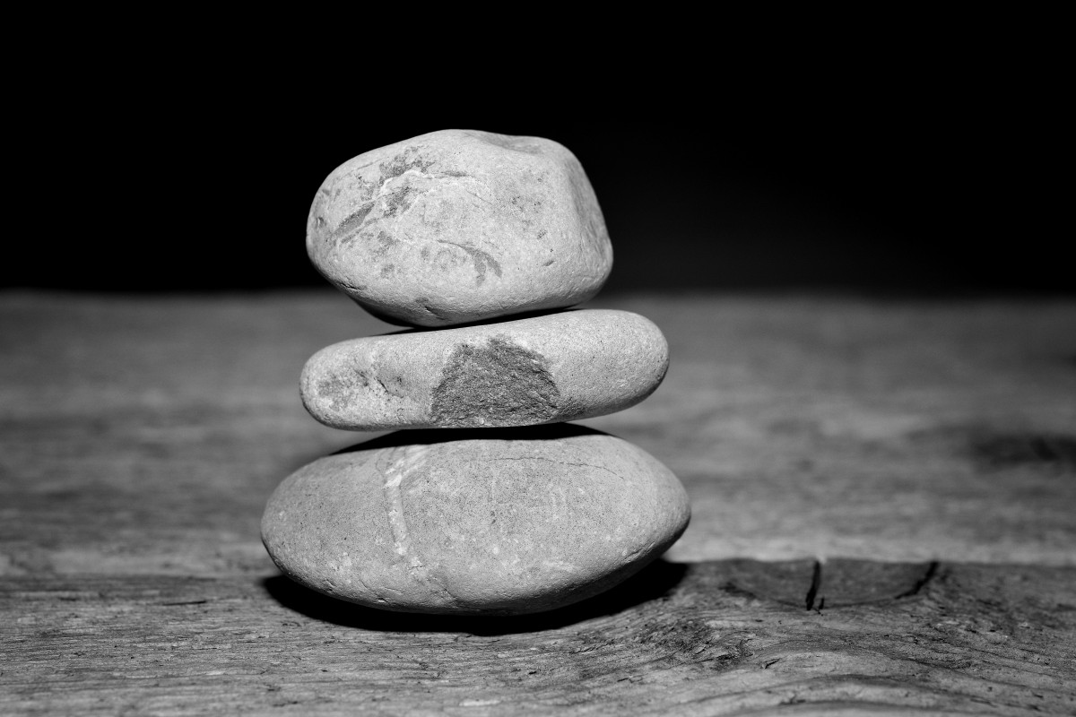
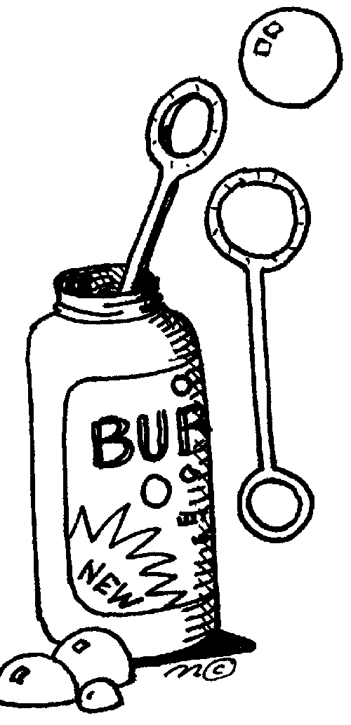




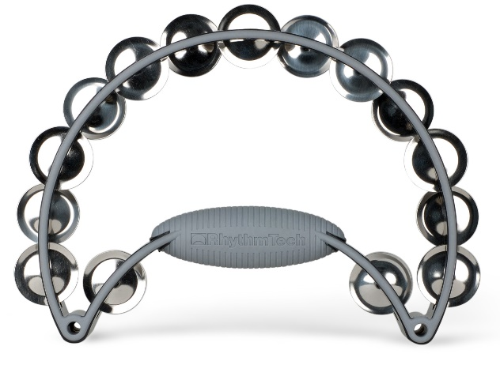
I can bring my communication device and there will be communication boards at the event I can use.
Craft
Badge making
Dental checks
Making pet rocks
Bubbles
Ambulance
BBQ
Children crossing
Duplo
Musical instruments

Slide 12

I'm looking forward to a fun day out!

